Slide 1
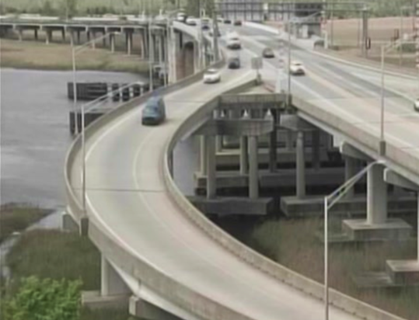
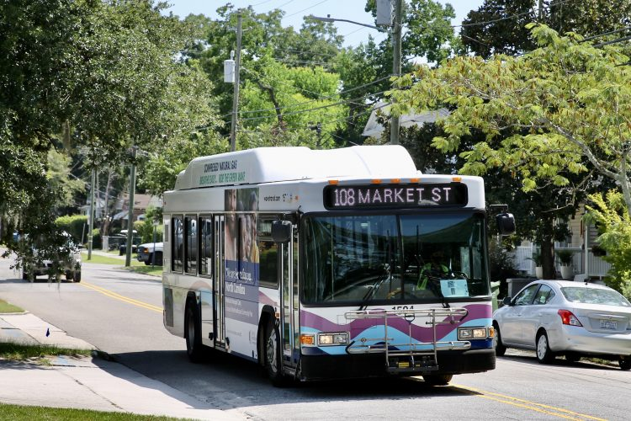
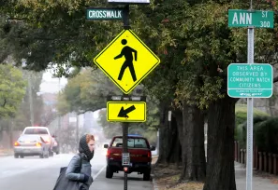
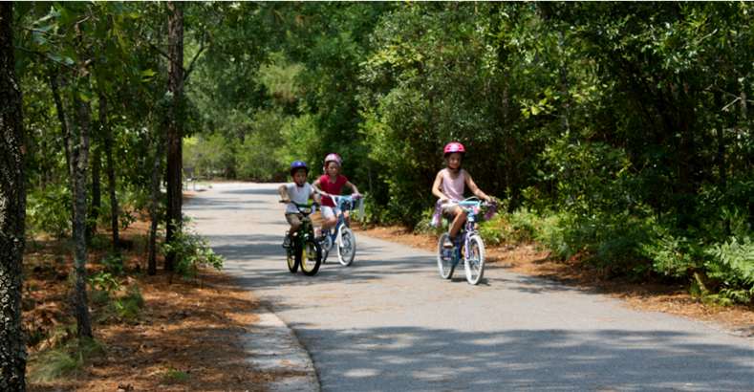
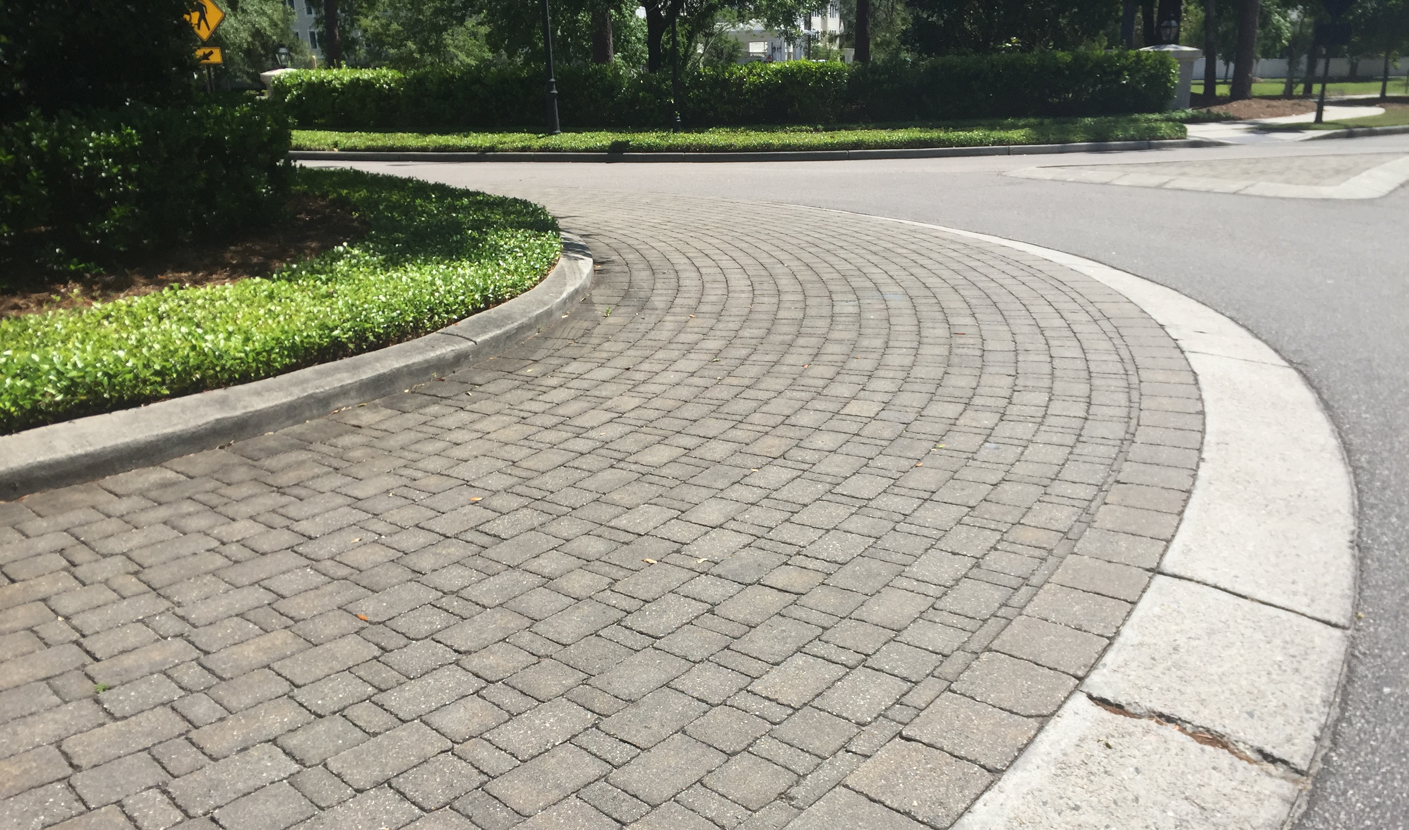
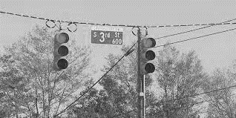
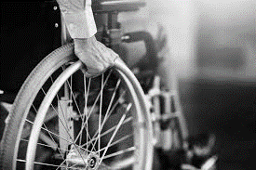

Preliminary Debrief
Transportation Bond
Ad Hoc Transportation Committee
April 17, 2025

Slide 2
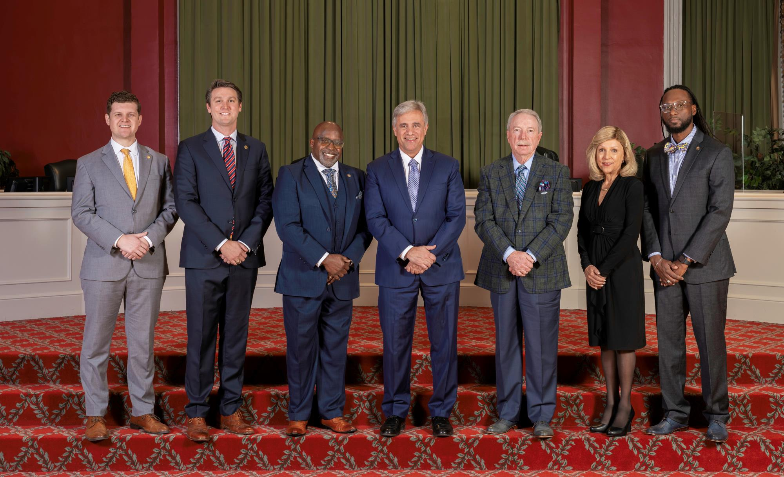
Vision for the Future
City Council supported an ambitious
transportation improvement program since 2014

Slide 3
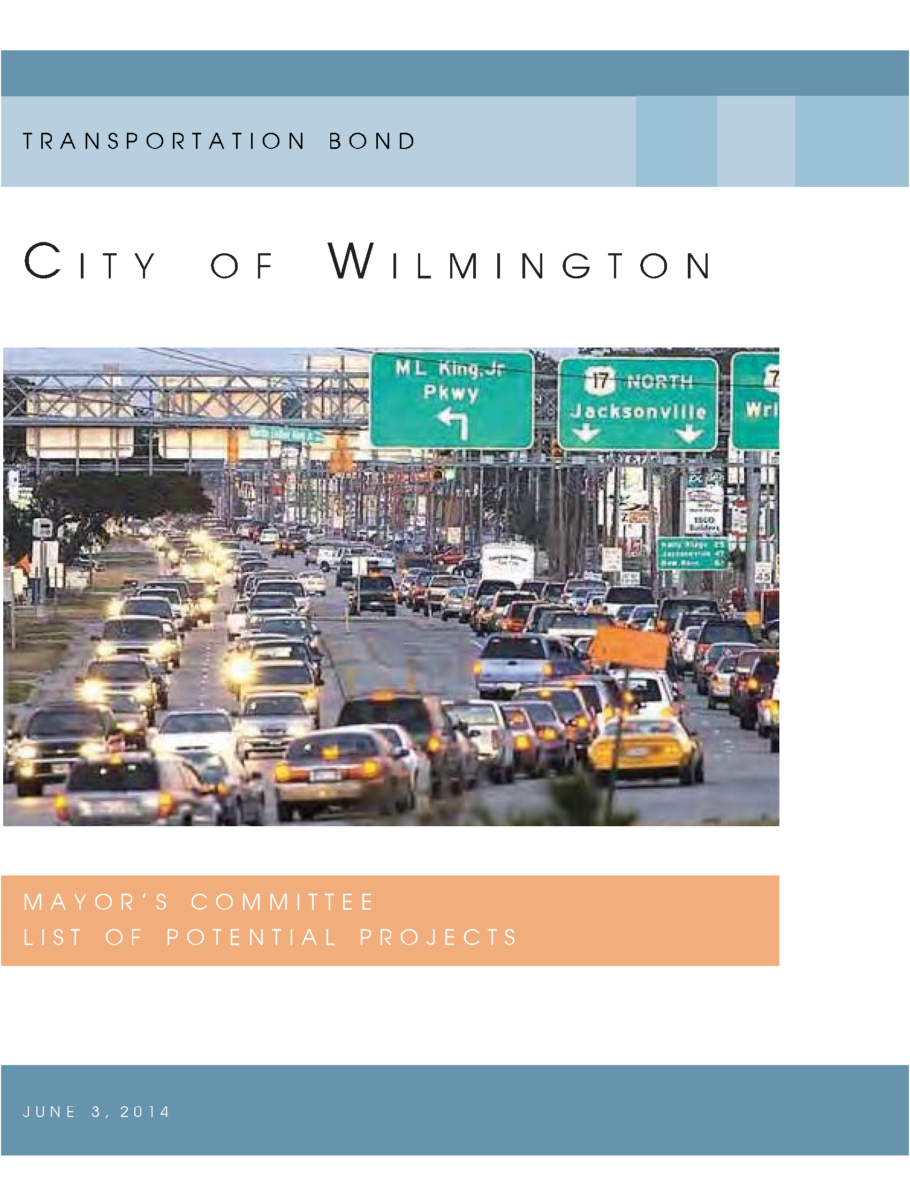
Bond Program Development
2014 Transportation Bond
Time Before the Referendum |  | Date | Description
9 | months | Feb-14 | Mayor’s Committee appointed
6 | months | May-14 | Mayor’s Committee recommendations
5 | months | Jun-14 | City Council authorizes LGC application
4 | months | Jul-14 | Public Hearing, Bond Order & Resolution
2 | months | Sep-14 | Hand-Off to Engineering Dept
0 | months | Nov-14 | Referendum

Slide 4
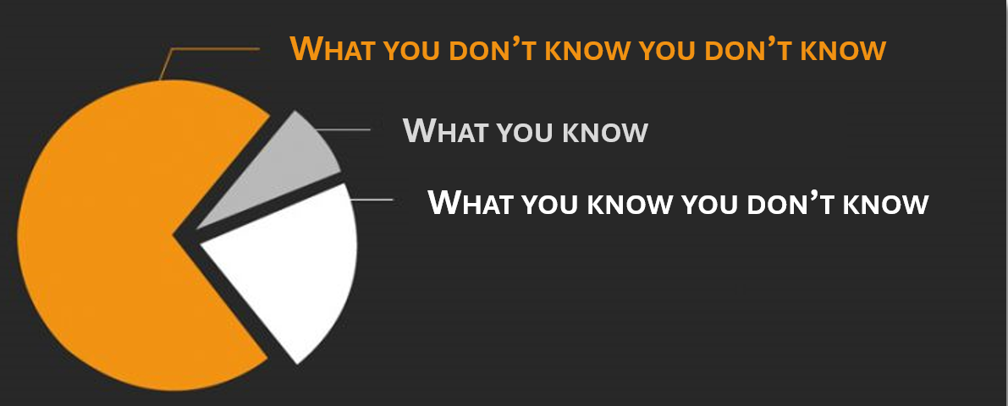
Setting the stage for the Transportation Bond
Former Deputy City Manager
February 2, 2015
“In my 30 years here, this is more projects than we’ve ever taken on at one time.”
It was understood we would encounter unknowns
Reference: 02/02/2015 City Council meeting, time 2:07

Slide 5
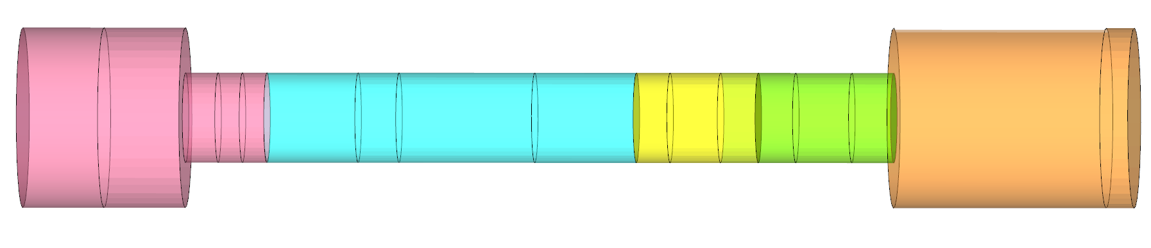
Project Delivery
The Project Pipeline
Planning
Design
ROW
Bidding
Construction
City Departments
Asset Owner
Engineering
Asset Owner
City Attorney
Engineering
Purchasing
Asset Owner
Engineering
Asset Owner
“bottlenecks” can occur at multiple points

Slide 6
Success Story
Project Selection
Engineering Staff Engagement
Transition from “Steady Run” to “Sprint/Marathon”
Develop Comprehensive Project Schedules
Major Factors Impacting Project Costs
Standing Up the Engineering Department in 2015
Lessons Learned
7 Findings

Slide 7
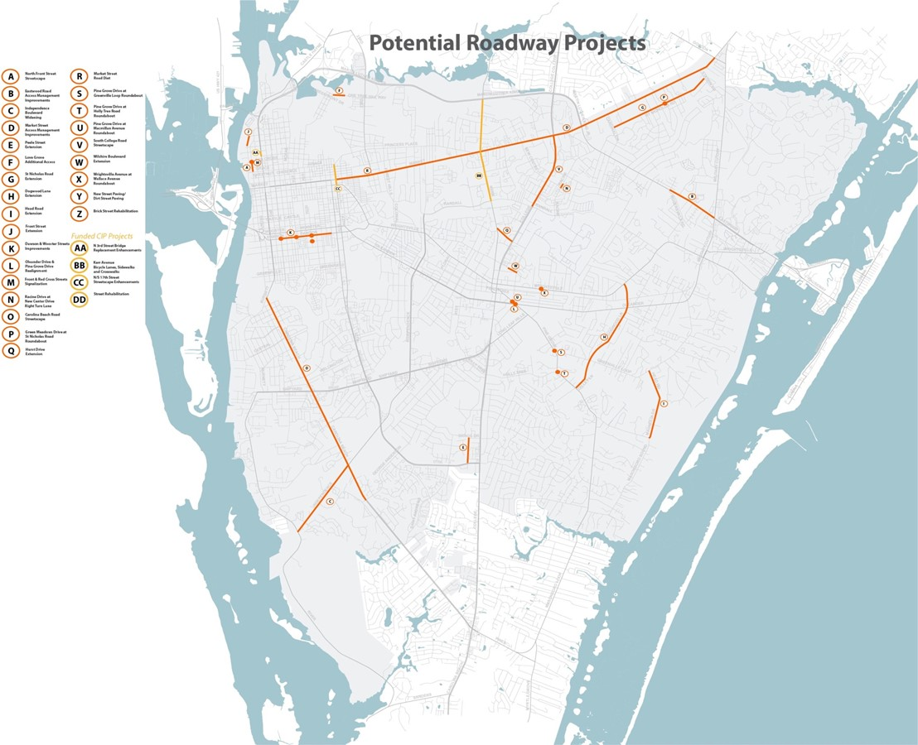
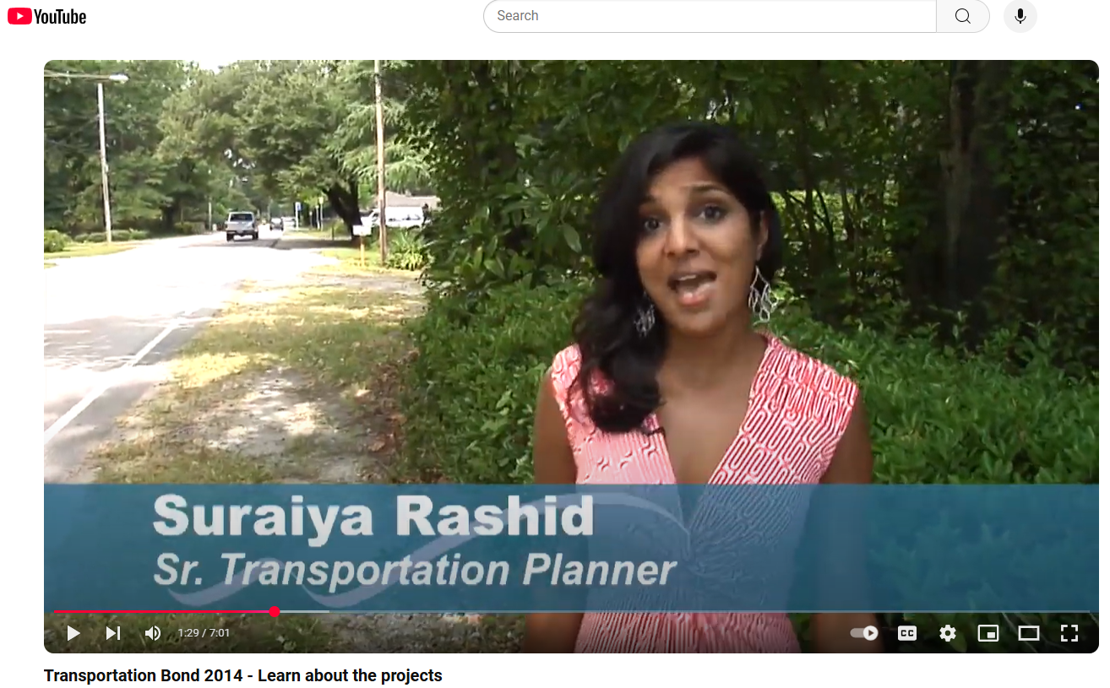
Finding #1: Success Story
February 2014
Potential Projects List
Project selection criteria
Public outreach
Bond Financing Program

Slide 8
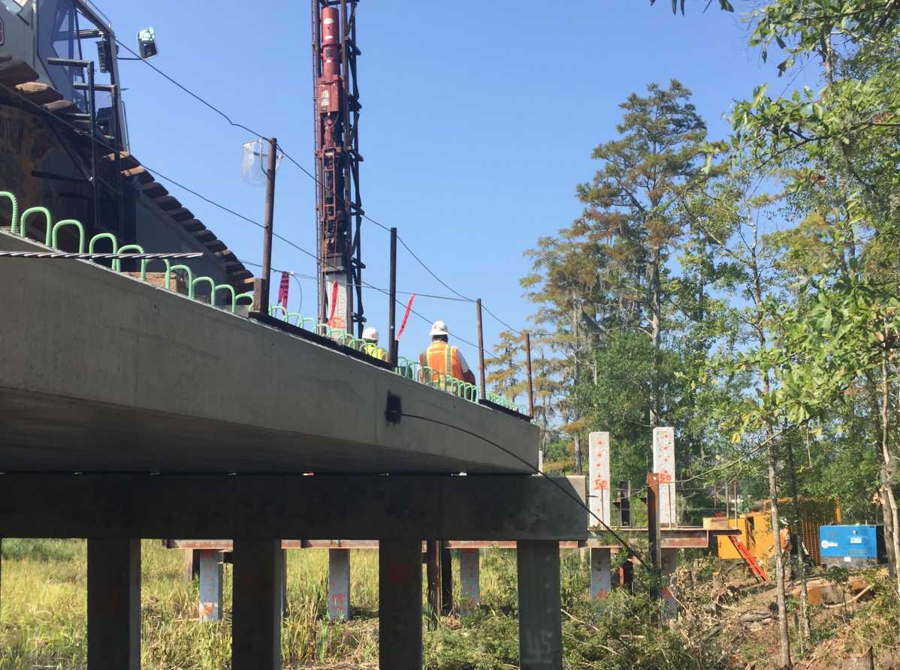
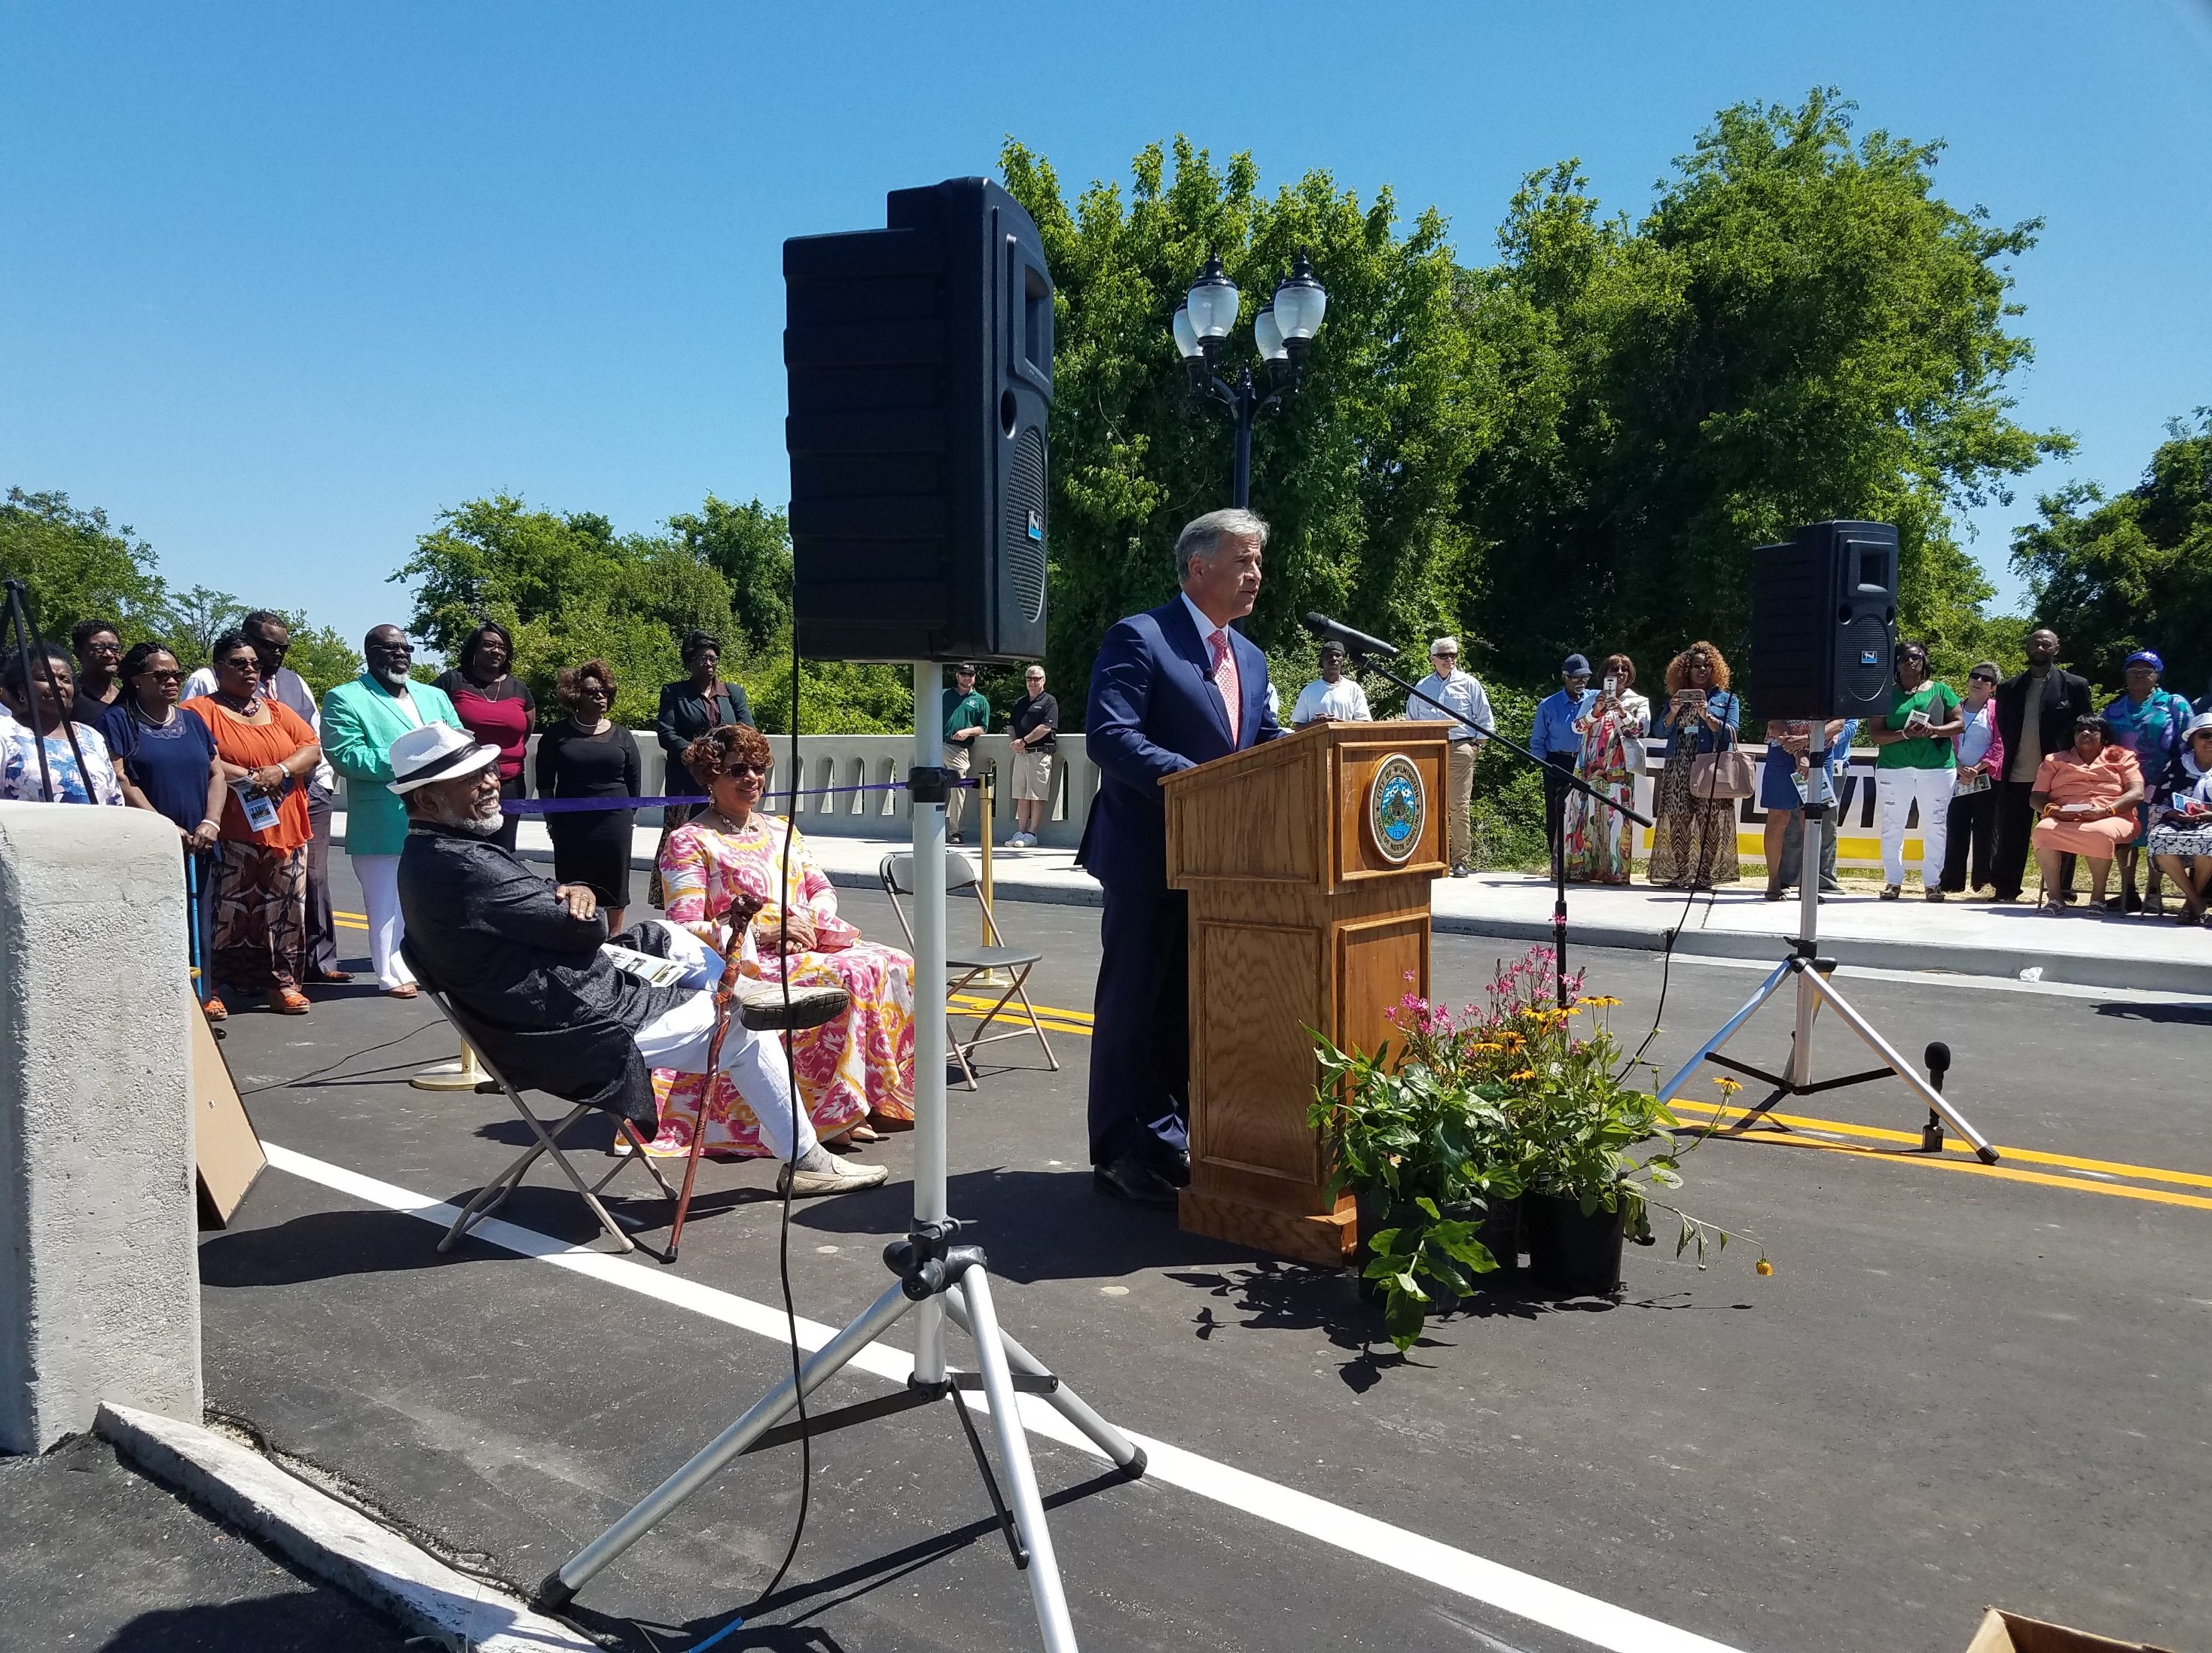
Finding #2: Project Selection
Love Grove Bridge was completed under budget in only 3 years
…involving a neighborhood, movie studio, stream, landfill, and heavy construction
Apr-2018
A feasibility study had already been done
Engineering Dept was leading from the start
No property acquisition
Why did this project go smoothly?

Slide 9
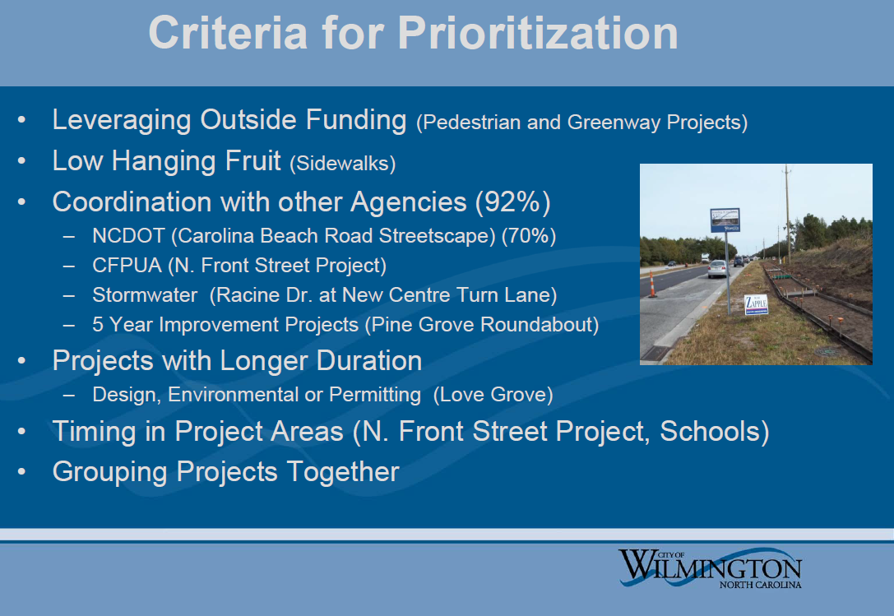
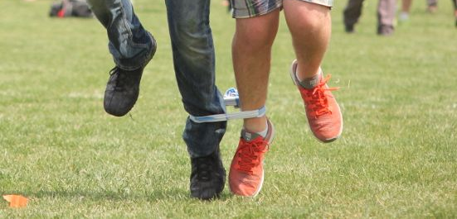
Finding #2: Project Selection (continued)
Former Deputy City Manager
February 2, 2015
Project Challenges
Extensive “coordination with other agencies” would be required
Lack of formal pre-coordination
The performance of outside agencies is beyond the control of city staff
Recommended additional criteria:
Electric & telecommunications utility impacts
Property acquisition complexity
Notes:
City Council Presentation
Former Deputy City Manager
February 2, 2015
Time 2:21:40

Slide 10
Finding #2: Project Selection (continued)
Project Challenges: Examples
Project | Factors Impacting Project Duration
Eastwood Rd Access: Phase 1 | Autumn Hall/St Mark’s Church coordination
Eastwood Rd Access: Phase 2 | Lidl agreement issues
Carolina Beach Rd | NCDOT funding on/off
Hurst Dr Extension | UNCW rejection after 3 years negotiating
Kerr Ave Trail | UNCW rejection after 3 years negotiating, extended project length
Wrightsville Ave Sidewalk | Property acquisition, Duke utility relocations, tree evaluation
Pine Grove Dr Intersections | Corridor study, NCDOT coordination, CFPUA & Duke utility relocations
North Front St | CFPUA, Business Impacts
17th Street MUP | Historic County Graveyard
Central College Trail | NCDOT stream crossing
Dawson & Wooster | NCDOT concept approval & project coordination
Oleander Sidewalks | NCDOT encroachments & traffic signal agreements
Greenville Loop Trail | Feasibility Study, conservation easements, CFPUA & Duke utility relocations, property acquisitions

Slide 11
Finding #3: Engineering Staff Engagement
In the future, provide time to refine cost estimates for selected projects
2014 Transportation Bond
Time Before the Referendum |  | Date | Description
9 | months | Feb-14 | Mayor’s Committee appointed
6 | months | May-14 | Mayor’s Committee recommendations
5 | months | Jun-14 | City Council authorizes LGC application
4 | months | Jul-14 | Public Hearing, Bond Order & Resolution
2 | months | Sep-14 | Hand-Off to Engineering Dept
0 | months | Nov-14 | Referendum
Refine Cost Estimates
If Engineering will be responsible for executing the projects, then the department should be included in development of the program.
For the next bond program, expand the schedule to include this task

Slide 12
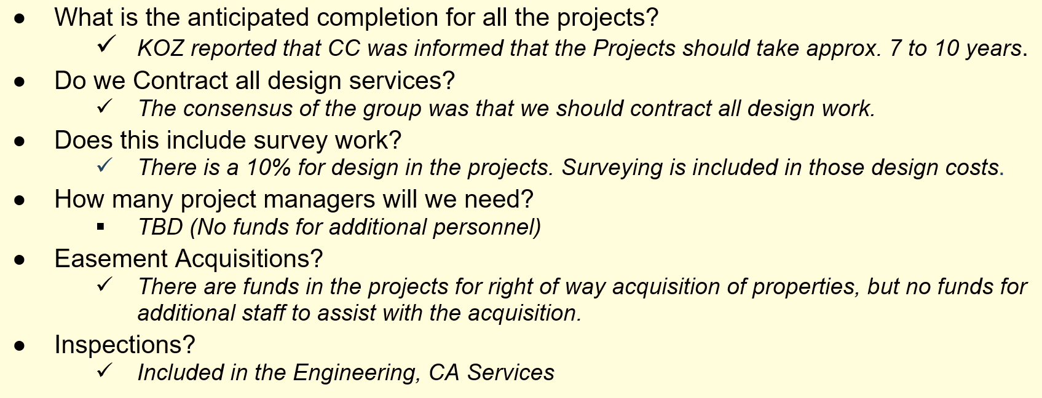
Finding #3: Engineering Staff Engagement (continued)
Hand-Off to Engineering
The design was underfunded at the start
Typical rule-of-thumb is 20% to 30% for engineering, surveying and inspection
Staff Committee Kick-Off Meeting
Sept 8, 2014
Original Timeline
No staffing analysis completed & no funding for additional staff provided.

Slide 13
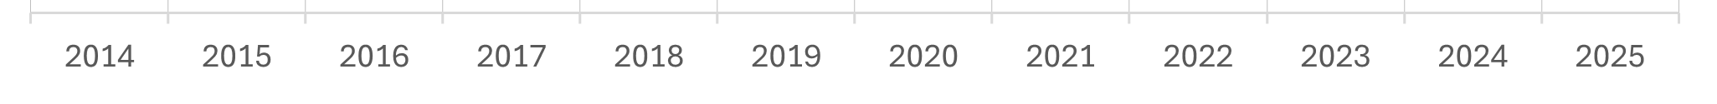
Finding #4: Transition from “Steady Run” to “Sprint/Marathon”
Approx $65M: 2002 to 2013
Major Project Assignments
2002
2003
2004
2005
2006
2007
2008
2009
2010
2011
2012
2013
Annexation Water & Swer
Riverwalk: Convention Center
Randall Pkwy Widening
N Front/Harnett St Improvements
Nutt St Realignment
Seagate Fire Station
Empie Park Fire Station
Eastwood Rd MUP: Phase 1
5th Ave Bridge Replacement
Riverwalk South: Nun to Dock
17th/Market Improvements
Independence Blvd Phase 2
Masonboro Loop/Sound Intersection
Riverwalk: Sawmill Point
Riverwalk: Conlon Pier
Riverwalk: Hilton/Ballast Hotel
5th Ave Bridge Replacement
Masonboro Fire Station
Riverwalk: Riverfront Holdings
Front St (Market/Chestnut)
Riverwalk: Pocket Park Structural
Cross-City Trail: Empie/Randall
Cross-City Trail: UNCW
Riverwalk: Market St Bulkhead
N Third St Improvements
Cross-City Trail: S. 17th St
Nutt St Drainage Outfall
Seagate Fire Station
Riverwalk: Governor’s Landing
# of PM Positions
Vacancies not shown

Slide 14
Finding #4: Transition from “Steady Run” to “Sprint/Marathon” (continued)
Approx $260M: 2014 to 2025
Major Project Assignments
2014
2015
2016
2017
2018
2019
2020
2021
2022
2023
2024
2025
Eng Division to
Eng Department
Consultant Contracts Executed
Hurricane Florence
COVID Pandemic
(Supply Chain)
Hurricane Helene
(Bid Impacts)
Staff Committee
Kick-Off Mtg
Riverplace
Peace Baptist Church Sidewalk
Indep Blvd Screen Wall
CIPAce
Shipyard Fire Station
Indep/River Roundabout
Riverwalk South Handrails
Greenville Loop Sidewalk
4th St Bridge Rehabilitation
Marina Riverwalk
Riverwalk Pier Demo
Towles Rd Emerg Access
Medical Center Sidewalk
Riverwalk Vehicle Damage
The City Manager guided a slowdown in the CIP to allow the backlog to be reduced
TRANSPORTATION BOND
Love Grove Bridge
Dawson & Wooster Streetscape
Crosswalks: 8th/Dawson/Wooster
Central College Trail
Sidewalk: Fairlawn Area (4 Streets)
Sidewalk: Dawson St
TRANSPORTATION BOND
Sidewalk: Oleander #1
Sidewalk: Oleander #2
Sidewalk: Oleander #3
Hurst Rd Extension
Sidewalk: 17th St
TRANSPORTATION BOND
PineGrv/McMillan Intrsctn
PineGrv/Oleander Intrsctn
Sidewalk: Delaney
Eastwood Rd Access Mgmt
EJCDC
Pine Grove Bridge
CFCC Riverwalk
Annual Pavement Markings
Water St Park: Area 4
Barclay/17th St Ped Improv
Bridge Invstmt Program Grant
TRANSPORTATION BOND
Sidewalk: Wrightstville #1
Sidewalk: Wrightstville #2
Sidewalk: Wrightstville #3
Rndabt: Wrghtsvll/Wallace
Rndabt: PineGrv/GrnvllLoop
Rndabt: PineGrv/HollyTree
TRANSPORTATION BOND
Carolina Bch Rd
N Front St
Racine/New Centre
Greenville Loop Trail
Brooks Bldg Riverwalk
Princess Place Sidewalk
Water St Park: Area 2
Water St Park: Area 3
Riverwalk: Harnett to Cowan
Conlon Pier Timber Platforms
Riverwalk: Coastline Inn
TRANSPORTATION BOND
Masonboro Loop Trail
Sidewalk: 23rd St
Crosswalk: 5 Projects
Kerr Ave Trail
Hawksbill Causeway
Downtown Trail Support
Riverwalk Vehicle Damage
Riverwalk Visitor Center
PARKS BOND
Olsen Park (+ Maint Bldg)
Capital Improv Program Oversight
Bijou Park
STP-DA
Wrightsville/Greenville Intersection
Hinton Ave Multi-Use Path
Hooker Road Multi-Use Path
Holly Tree Crossings
Park Ave Multi-Use Path Ph. 1
Park Ave Multi-Use Path Ph. 2
5th Ave Intersection Improv
Parks Maintenance Facility
Riverwalk Structural Repairs
Cinema Dr Fire Station
6th St Bridge Repair
Pine Grove Bridge Repair
Tax rate and budget constraints necessarily delayed additional positions
Riverfront Assessment
Annual Pavement Markings
Front St Bridge Rehab
3rd/Ann Traffic Signal
Market/21st HAWK Signal
17th St MUP (Harbour/Shipyard)
The Range/Oleander MUP
Greenville Loop Guardrail
William Booth Dr Extension
Manly Ave/GLOW
Chestnut/Grace Improv
Red Cross Riverwalk
Dock St Riverwalk
RiverLights Fire Station
PARKS BOND
nCinco Sports Complex
MLK Community Center
# of PM Positions
Police/Fire Training Fac
Riverfront Assessment
Kentner/Wrghtsvll
Chestnut Elevated Walkway
Traffic Signal Preemption
PARKS BOND
Riverfront Park
Kayak Launch
Vacancies not shown
Does not include Stormwater Svcs projects managed by dedicated PMs

Slide 15
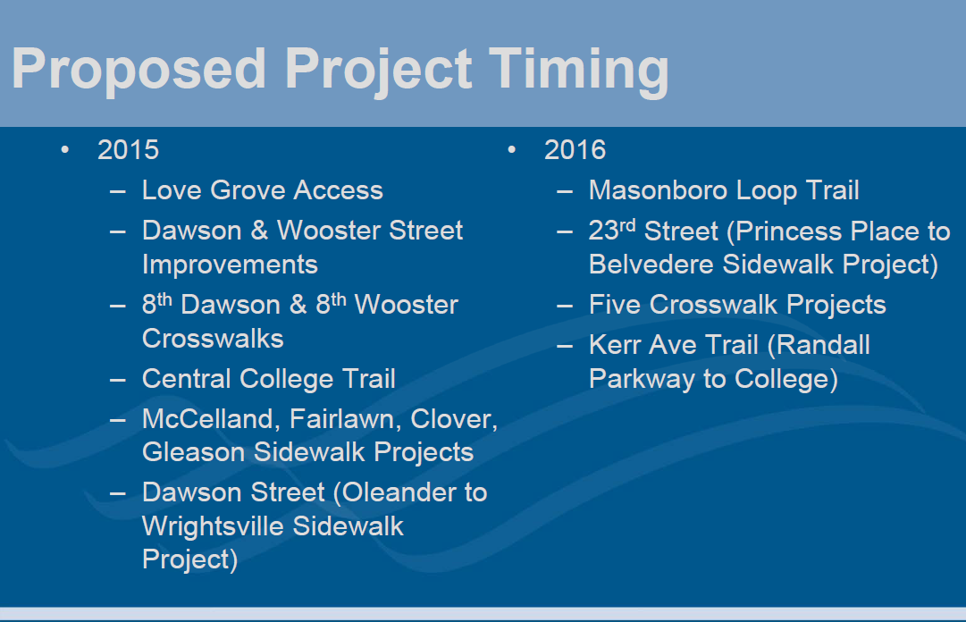
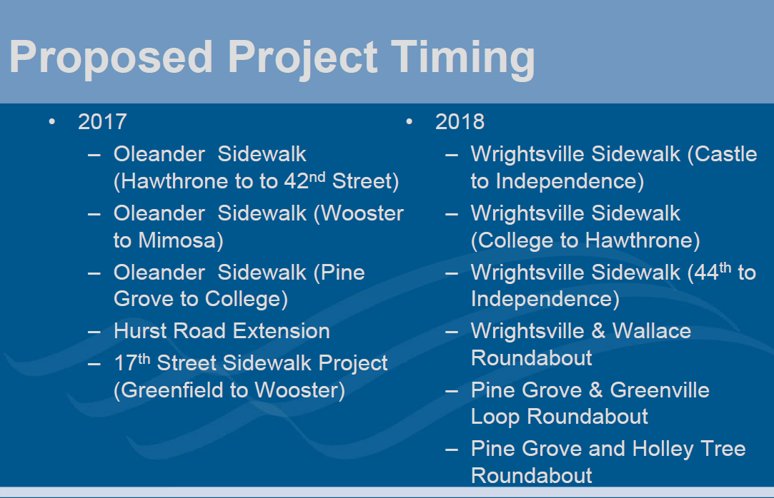
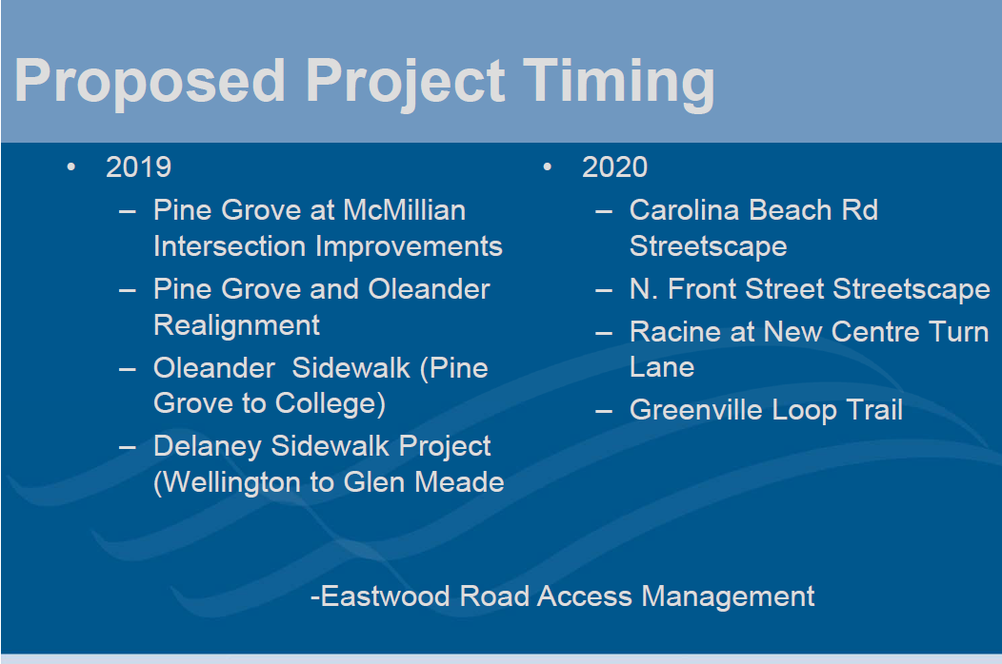
Finding #5: Develop Comprehensive Project Schedules
Original Start Dates
Actual Program Start-Up
Transportation
Bond Funded
Jul-2015
Former Deputy City Manager
February 2, 2015
2 New Project Managers Hired
Oct-2015
Consultant
Contracts: Begin Design
Feb-2016
Year 1
Year 2
Year 3
Year 4
Year 5
Year 6
Typical Timeline
Bid 2017 to 2018
Complete 2019
Typical Timeline
Bid 2018 to 2019
Complete 2020
Typical Timeline
Bid 2019 to 2020
Complete 2021
Typical Timeline
Bid 2020 to 2021
Complete 2022
Typical Timeline
Bid 2021 to 2022
Complete 2023
Typical Timeline
Bid 2022 to 2023
Complete 2024
Notes:
City Council Presentation
Former Deputy City Manager
February 2, 2015
Time 2:20:40

Slide 16
Finding #5: Develop Comprehensive Project Schedules (continued)
Reality
Expectations
Expectations
City Council was informed that the projects
should take approximately 7 to 10 years
…never in my wildest years did I think that 10 years after voting for this bond we still would not have a path on Greenville loop.
Kick-Off Staff Committee Mtg
09/08/2014
This project is about 1-1/2 years behind the original schedule
The best-case extrapolation of the former DCM’s start dates prescribed an earliest completion in 2025
Begin Project Phase | Planned | Actual
Feasibility Study | 2020 | 2020
Design & Permitting | 2021 | 2021
Right-of-Way Acquisition | 2023 | 2023
Construction | 2024 | 2025
Complete | 2025 | 2026
Jonathan Long, Chilcot Lane Area
Email to City Council, 08/15/2024

Slide 17
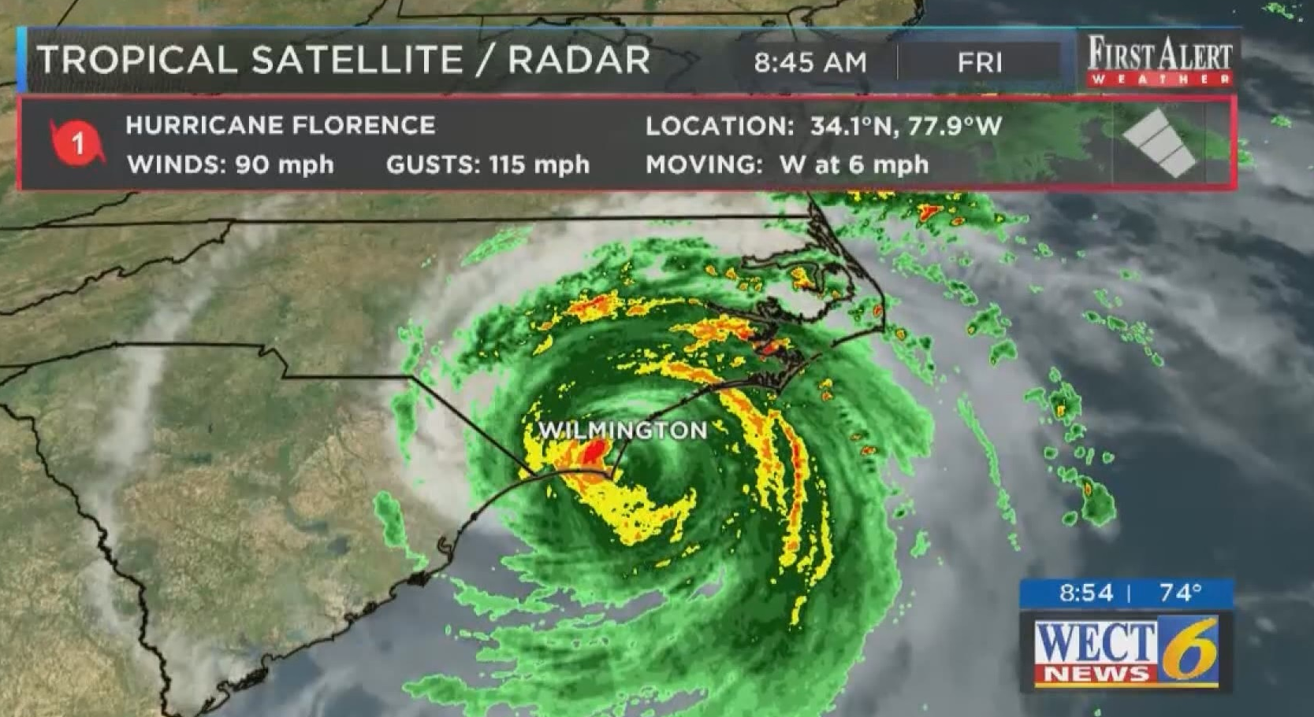
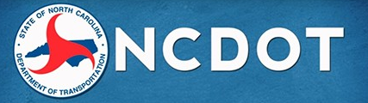



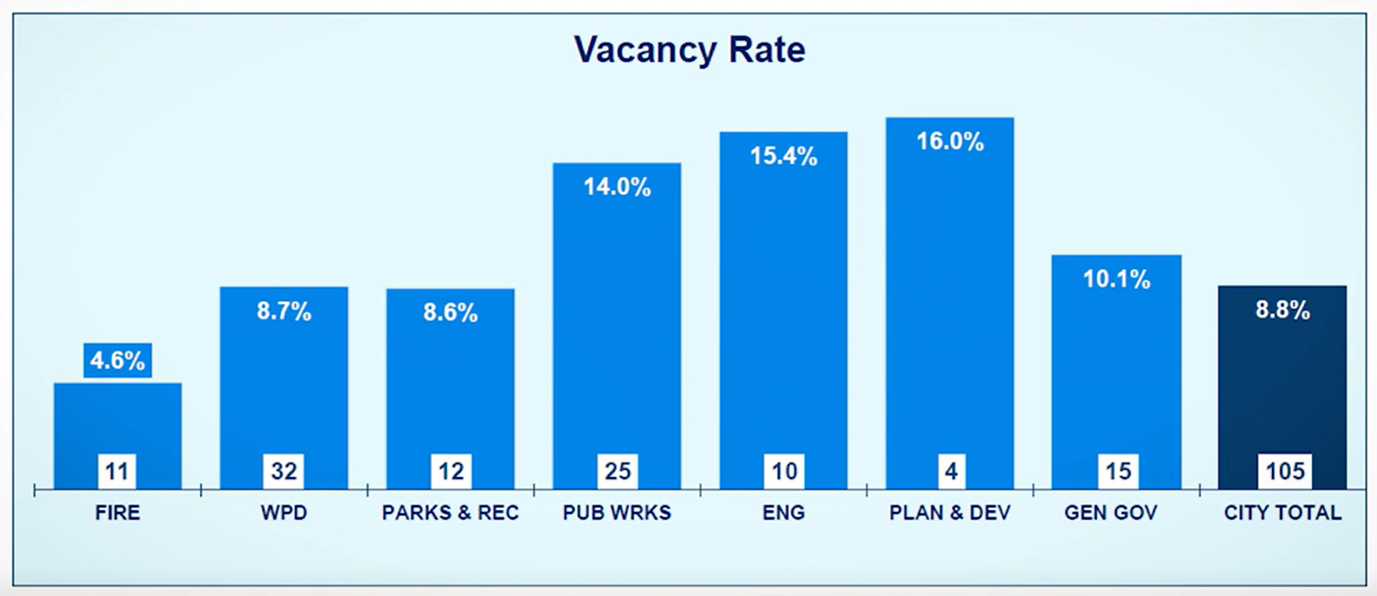




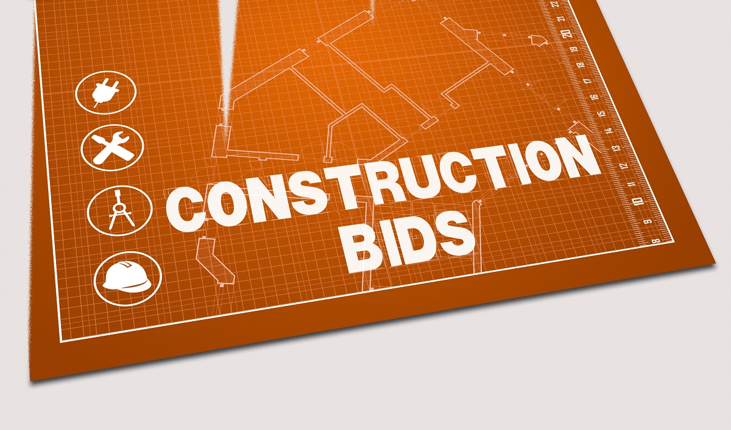
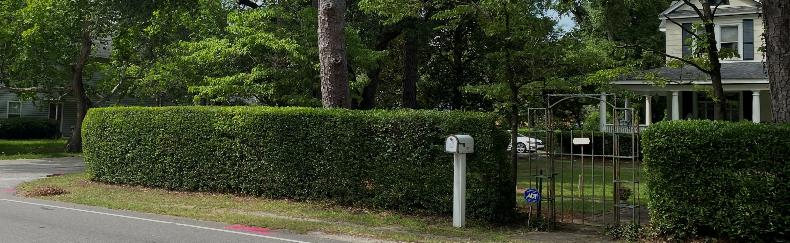
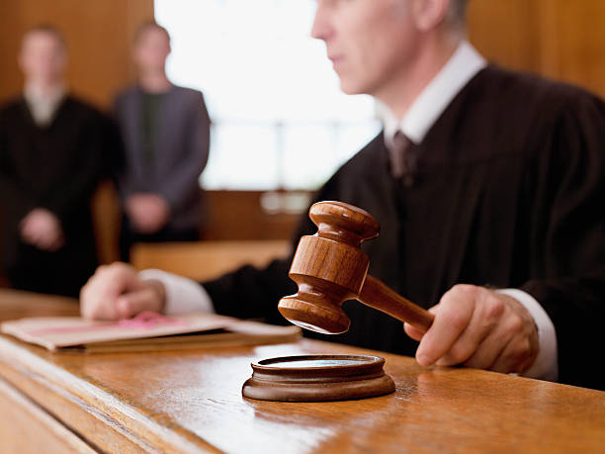

Finding #5: Develop Comprehensive Project Schedules (continued)
Assess Project Delivery Drivers:
Staff Resourcing
Consultant Performance
Contracting Environment
Permitting Agencies
Partnership Issues
Property Owner Opposition
Utility Relocation by Others
Litigation
Pop-Up Projects
Economic Shifts
Disasters
Budget Work Session
January 31, 2025

Slide 18

Greenville Loop Rd & Holly Tree Rd
Finding #6: Major Factors Impacting Project Costs
What were the Potential Projects List cost estimates suitable for?
Potential Projects List |  | Yes
Bond Financing |  | No

Slide 19
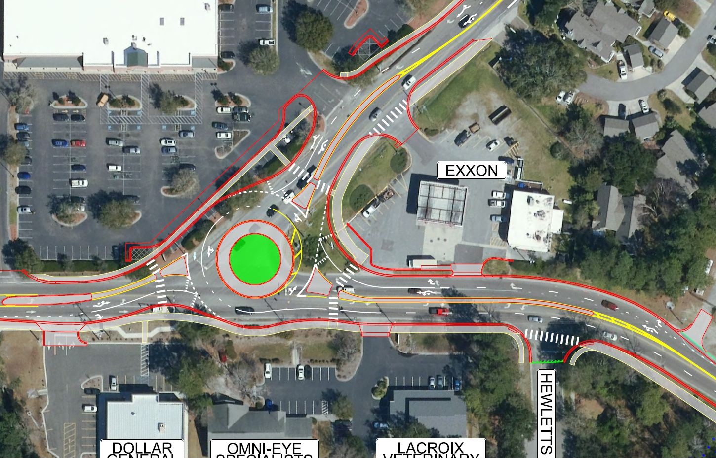
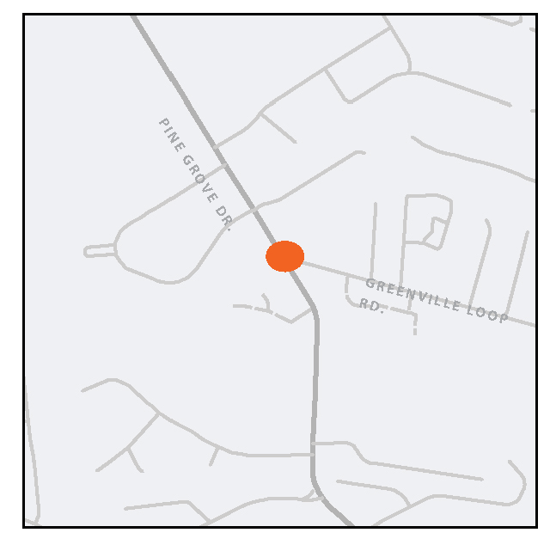
Finding #6: Major Factors Impacting Project Costs (continued)
Pine Grove Dr Southern Intersections
Greenville Loop Rd & Holly Tree Rd
Pine Grove Dr Southern Intersections
Potential Projects List Scoping
Project Delivery Scoping
Identifier | Name | Estimate
R-11 | Pine Grove Drive at Greenville Loop Roundabout | $ 1,500,000
Dual-lane roundabout & road widening required
The construction of a roundabout to improve the traffic flow at the intersection of Pine Grove Drive and Greenville Loop Road. This project will improve the safety of the intersection of Pine Grove Drive and Greenville Loop Road by introducing a roundabout to encourage free flow of traffic and reduce the number of conflict points.

Slide 20
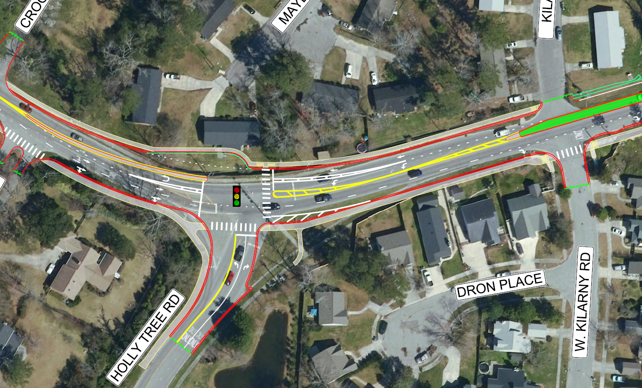
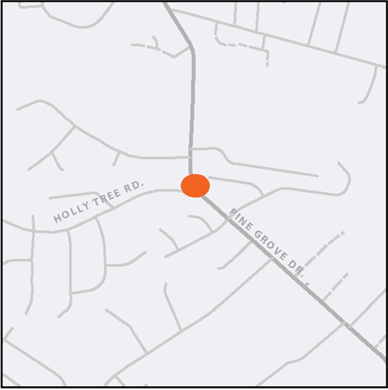
Finding #6: Major Factors Impacting Project Costs (continued)
Pine Grove Dr Southern Intersections
Potential Projects List Scoping
Project Delivery Scoping
Identifier | Name | Estimate
R-12 | Pine Grove Drive at Holly Tree Roundabout | $ 1,500,000
Roundabout would not have functioned
The construction of a roundabout to improve the traffic flow at the intersection of Pine Grove Drive and Holly Tree Road. This project will improve the safety of the intersection of Pine Grove Drive and Greenville Loop Road by introducing a roundabout to encourage free flow of traffic and reduce the number of conflict points.

Slide 21
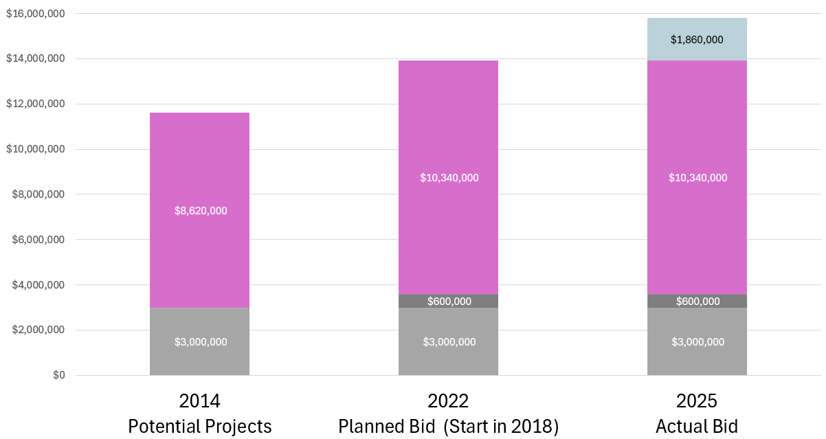
Finding #6: Major Factors Impacting Project Costs (continued)
Pine Grove Dr Southern Intersections
unknown
Current Bidding Environment
$15.8M
$13.9M
Engineering
Workload/Staffing
Delay Costs
Scope Gap
Inflation
Scope Gap
Inflation
$11.6M
Scope
Gap
Scope
Gap
Scope
Gap
Potential Projects List
Cost Estimate
Inflation
Planned Begin Phase
Corridor Study | 2018
Design | 2019
ROW | 2020
Bid | 2022

Slide 22
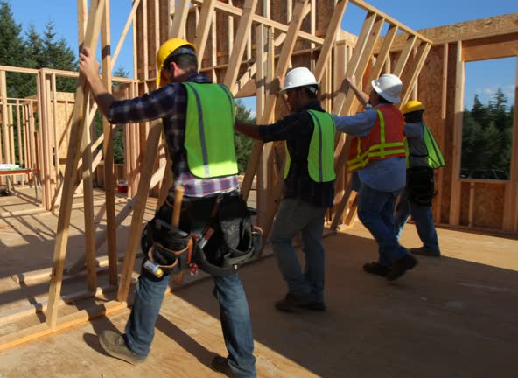
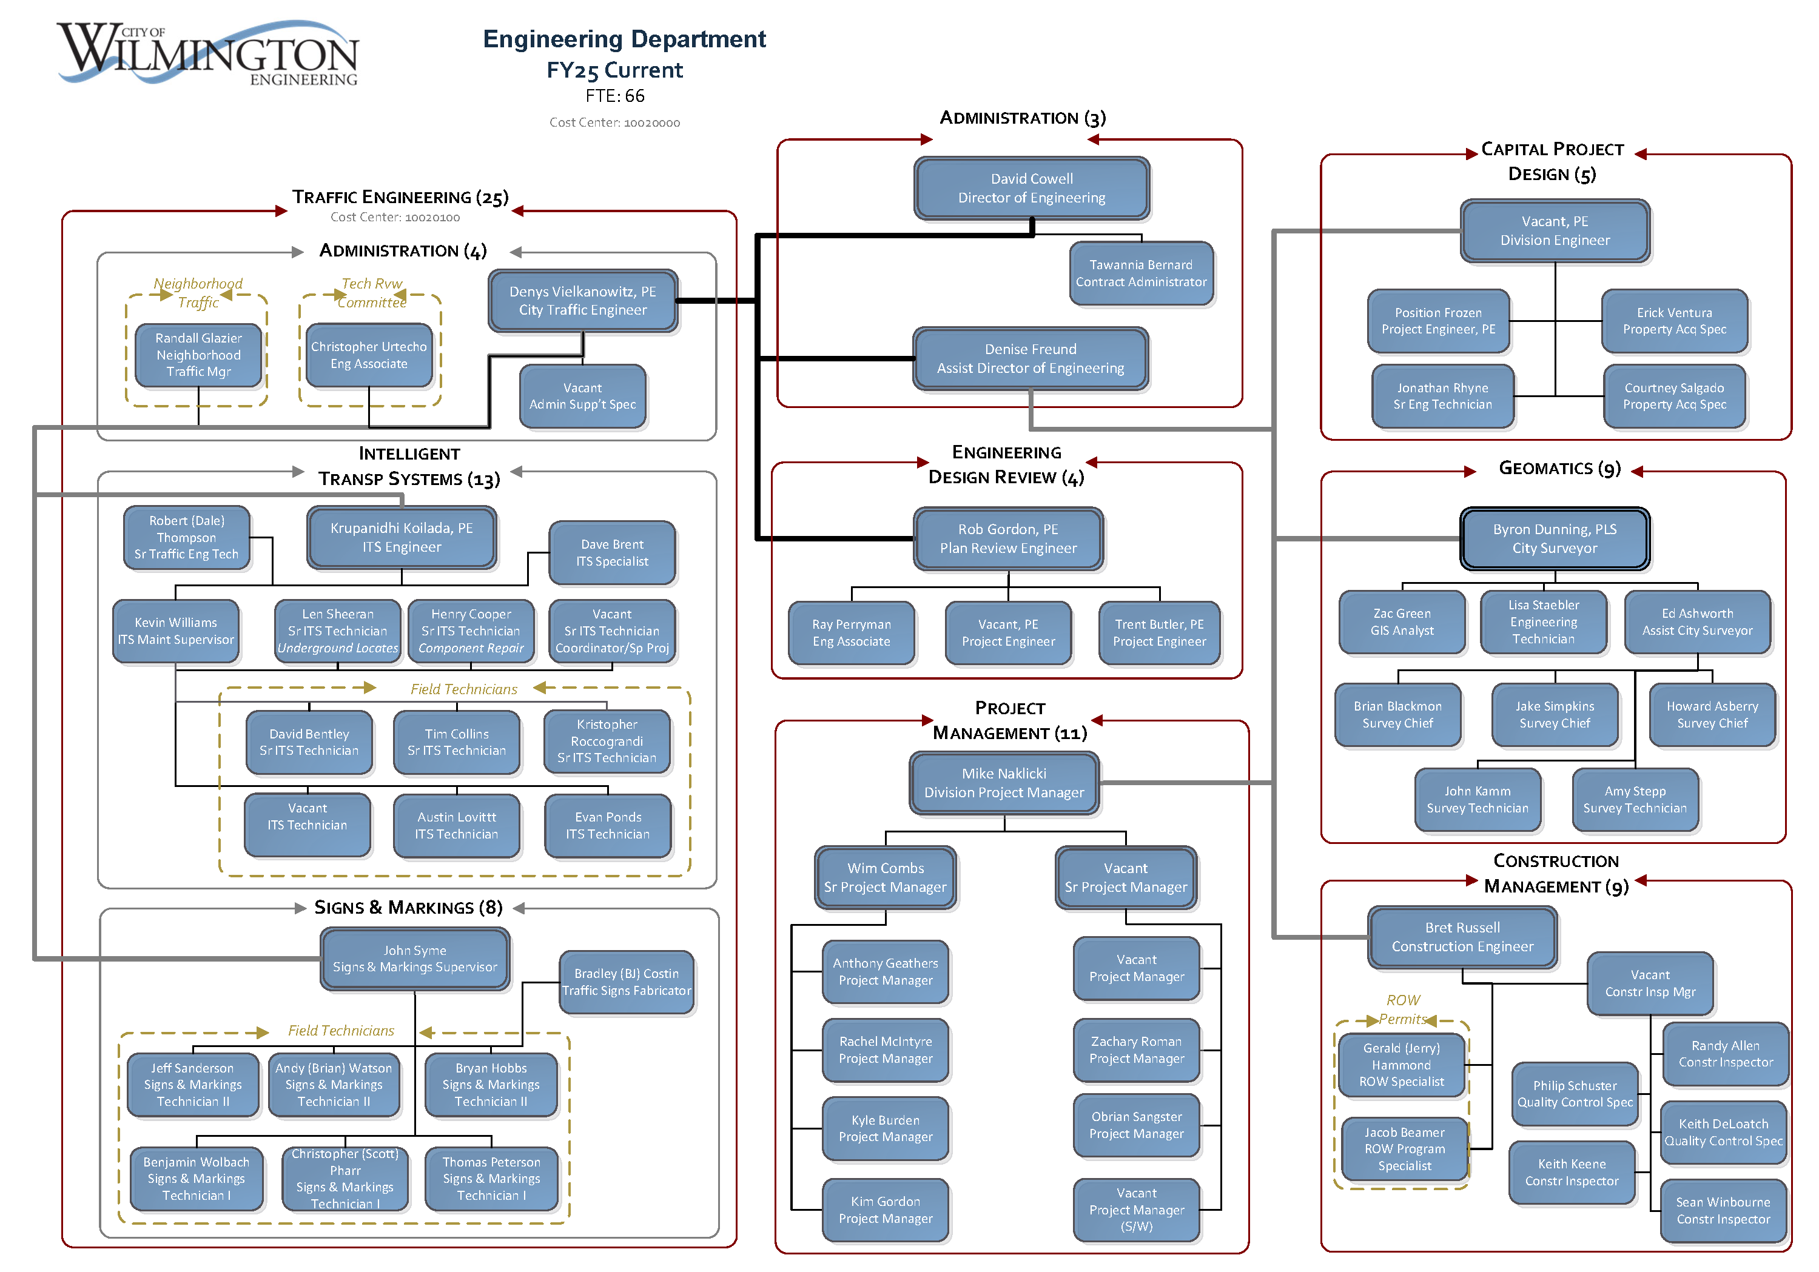
Finding #7: Standing Up the Engineering Department in 2015
In 2015 (three months after the transportation bond was funded),
the Engineering Division transitioned to the Engineering Department
The Assistant Director of Engineering position was created in 2021
Scope Gap
Inflation

Slide 23
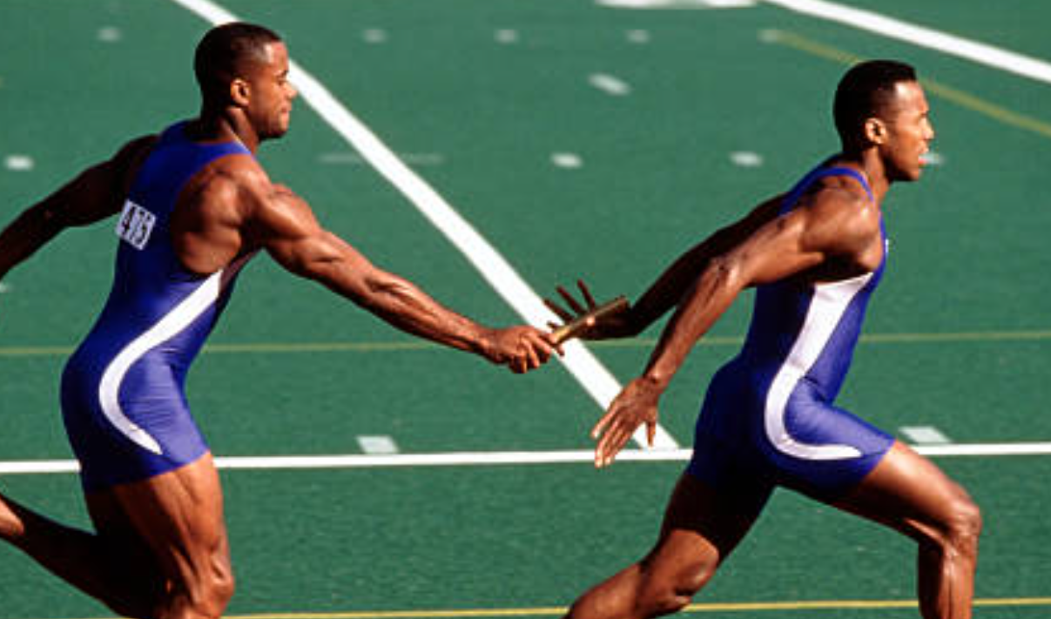
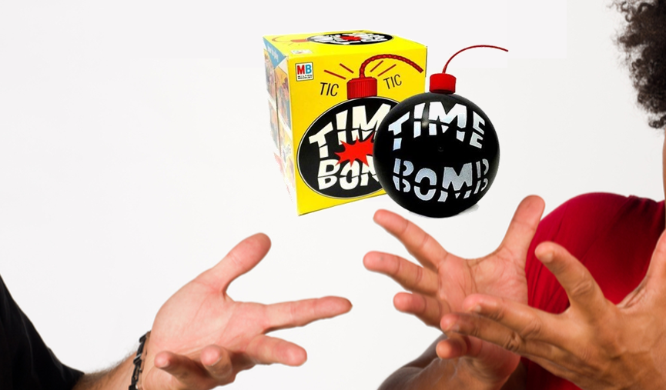
“Do the work on the front end” - Thom Moton, Deputy City Manager
Lessons Learned
Project Selection: Lower Percentage Requiring Outside Agency Coordination
Pre-position staff across departments
Pre-position consulting contracts
Refined Scoping, Cost Estimates & Schedules
Feasibility Studies & Preliminary Design
Engage Engineering Dept Early
Increase project funding contingency
(actual 2014 Bond Program Contingency = 5%)
Project Sponsor
Engineering Dept
Obstacles

Slide 24

Thank you
for your continued support of the women & men working to deliver capital projects

